Slide 1
Project title: Flight Booking System
Submitted By: Supervised By:
DBS-Hackthon
Table no 37

Slide 2
Abstract
The project aims to design & implementation of an air ticket reservation system which will provide customers a facility to reserve there tickets without any hassle. It is a web based system & it will save valuable time and effort of air traveler. The air ticket reservation system designed in this project was developed using html, javaScript, css and Java as the programming languages and Mysql as the database Management system. The methodology adopted for this project is the Agile methods. This system allows real time communication between admin and user. This system allows the passenger to cancel his/her reservation, if any problem occurs and view price chat which did not occur in the existing system. This system allows the airline passengers to search for flights that are available between the two travel cities, namely the “Departure city” and “Destination city” for a particular departure and arrival dates. The system displays all the flight’s details such as flight number, name, price and duration of journey etc. After search the system display list of available flights and allows customer to choose a particular flight. Then the system checks for the availability of seats on the flight.Then it book the flight.

Slide 3
Objectives
To make air ticket reservation easier for passenger.
To save time and effort of potential air traveler.
To reduce the hassle of the user.

Slide 4
Introduction
Online Air Ticketing is a kind of user assistance where customers can reserve tickets for flight in online. This is an easy method which saves a lot of time. This project entitled design and implement of an air ticket reservation system can be applicable to any airlines. The feature of this system will be similar as a common ticketing system. As a user :
You can view the schedule
You can reserve ticket
You can cancel your reservation
You can confirm your reservation

Slide 5
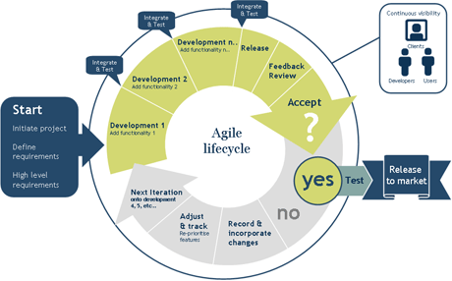
Methodology
A methodology is a set of ideas or guidelines about how to proceed in gathering and validating knowledge of a subject matter.
Agile methods
An Agile process is characterized by the division of task into short phases of work and frequent reassessment and adaption of plans.

Slide 6
Required Software
Windows 7 and Above
Adobe Dreamweaver
Adobe Photoshop
Vs code
Browser: Mozilla Firefox, googol chrome ,opera ,internet explorer
Language
HTML
CSS
JavaScript
Java
MySQL

Slide 7
Technical Requirements
Registration
Login
View schedule /Reserve ticket
Searching flight schedule
Viewing statistics
Uploading Information into the system

Slide 8
Types of User
Admin
Creating a flight
Changing time schedule
Creating a new route
Updating airport information
Registering and managing users
View statistics
Registered user
View flight schedule
Book, confirm/cancel reservation
Unregistered User
View flight schedule

Slide 9
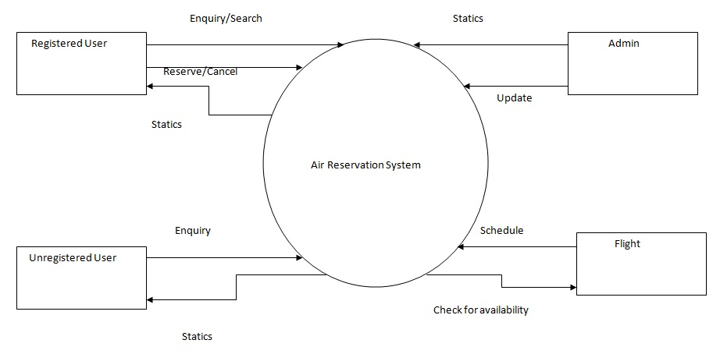
Data Flow Diagram

Slide 10
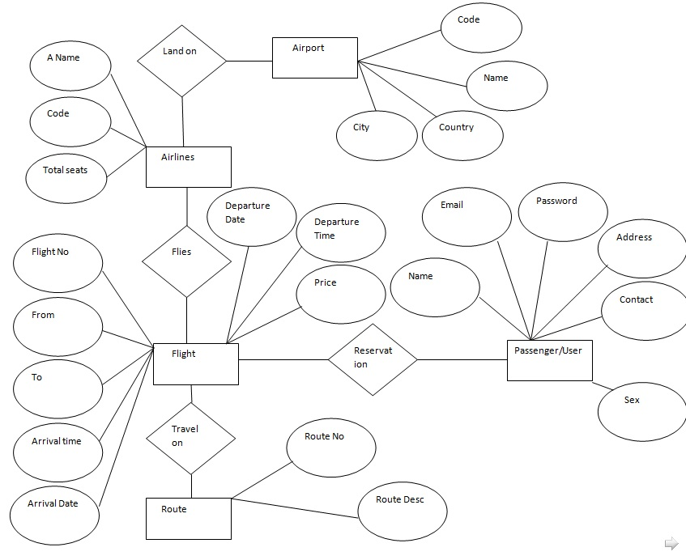
E-R Diagram

Slide 11
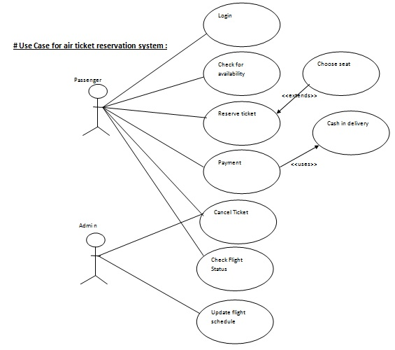
Use Case Diagram

Slide 12
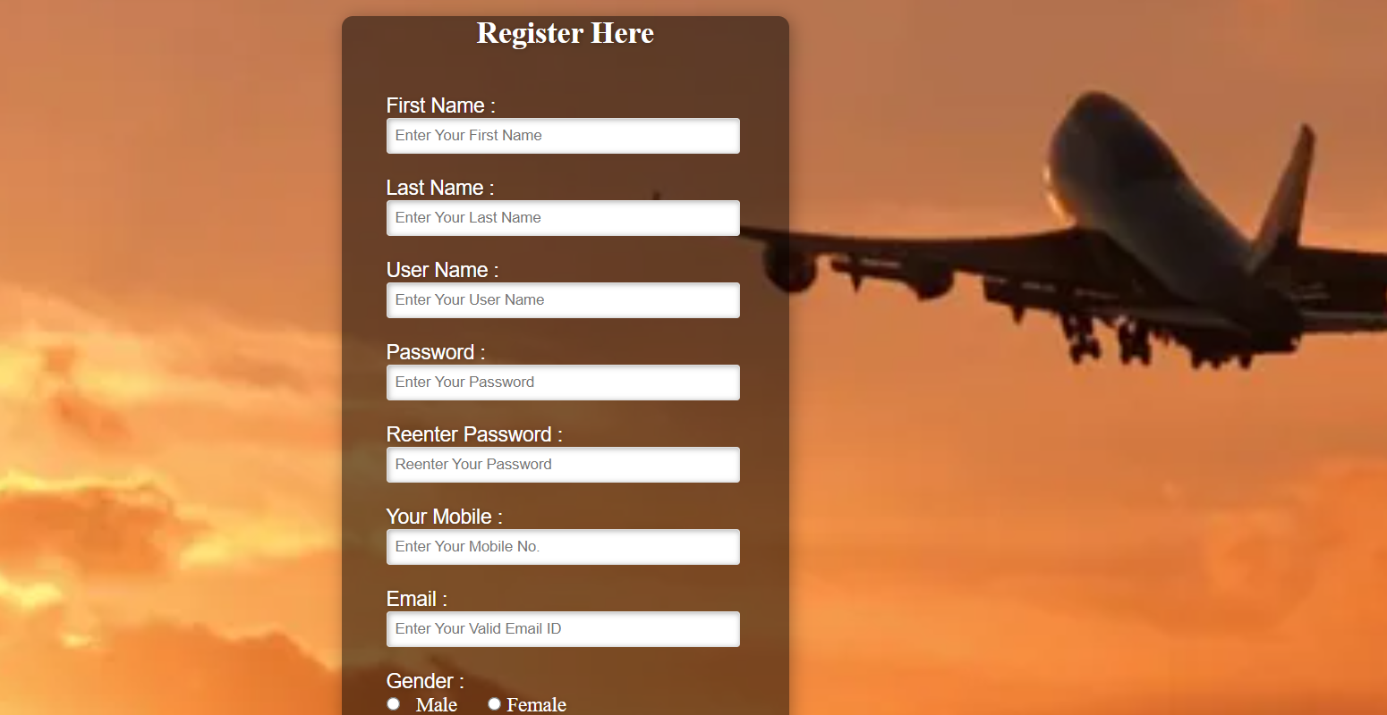
Project Description
Home Page
Home page introduces the site and user can understand that what facility we provide in this system. User can see search option and login, registration, schedule and contact mnu in home page. User can also see the latest offers & update schedule in home page.

Slide 13
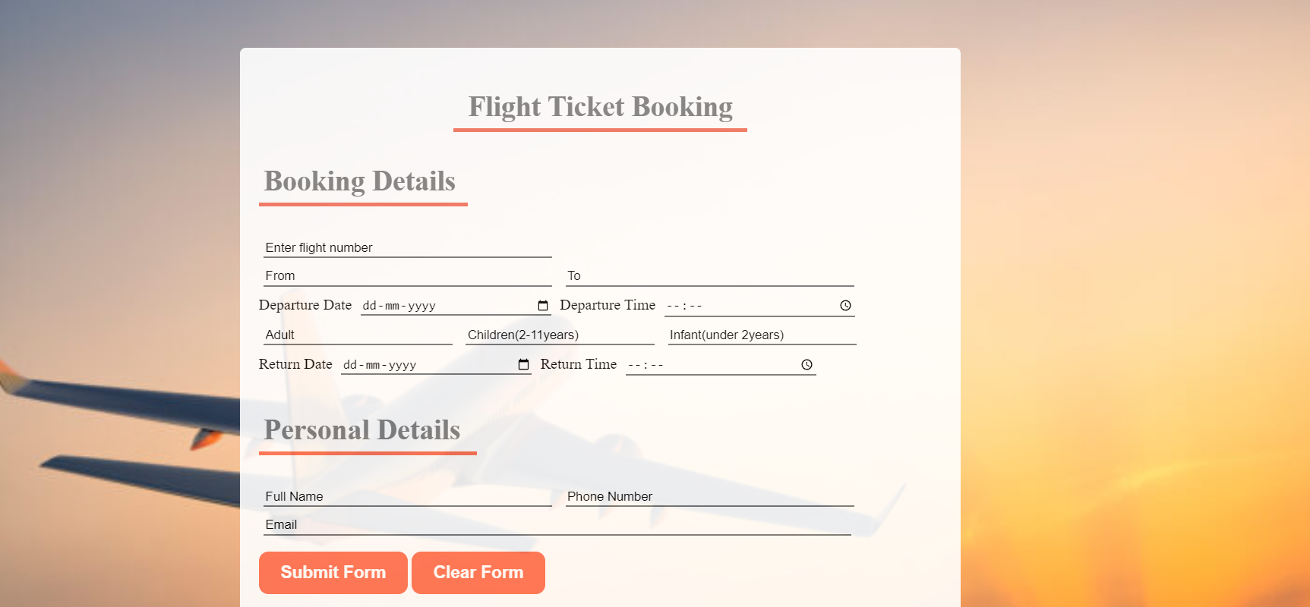
Registration Page
For reserve a ticket for flight a user must be registered into the system. A user must use valid email address and valid mobile number during registration. User information is stored into the database. Multiple user can not use the same email and mobile number. User must need to fill up all fields for registration.

Slide 14
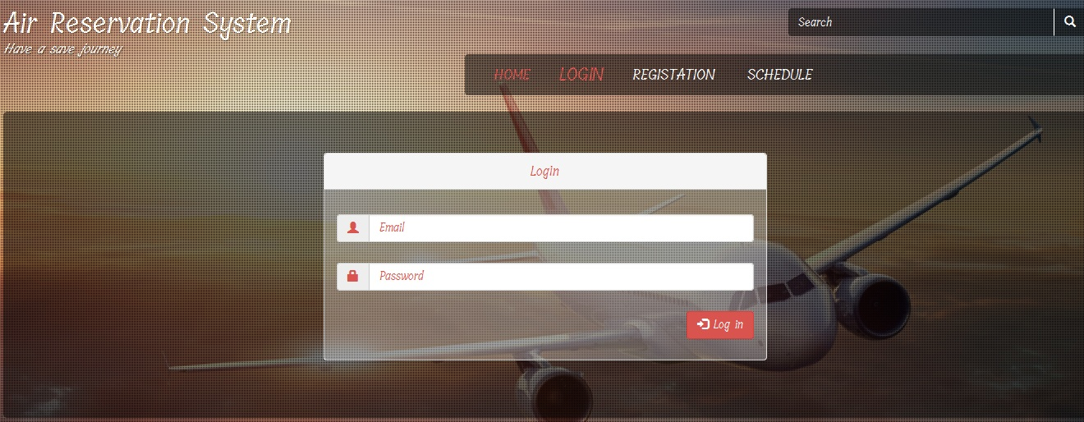
Login Page
A user must be login into the system for reserve, confirm and cancel ticket for flight. User required email and password for login that he provided during registration. User must use valid email address and password. Admin also need to login into the system for access the system.

Slide 15
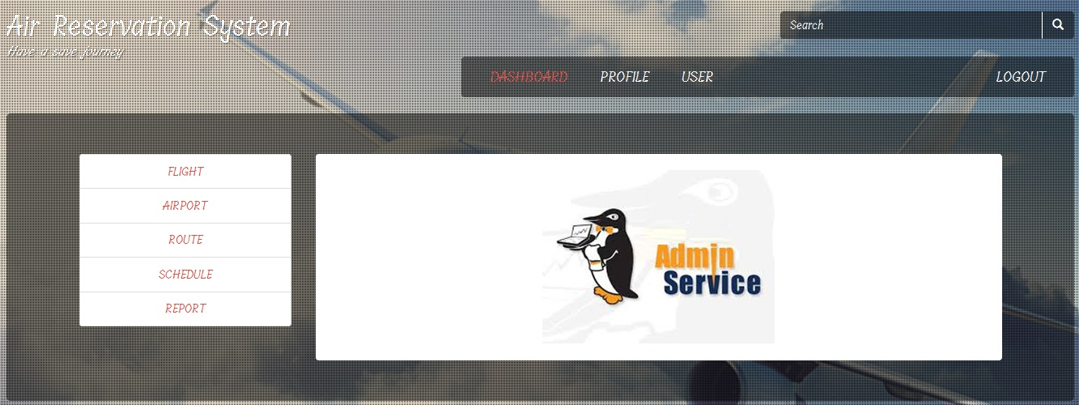
Admin Login When an admin login into the system admin will see this dashboard, admin usually perform these task (edit profile, add flight, add route, add schedule, add airport info, generate report.)

Slide 16
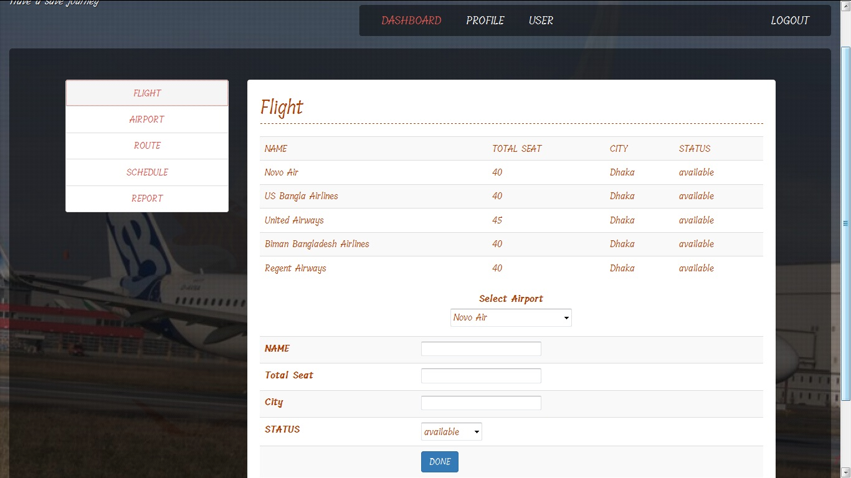
Create Flight Admin can create flight here by giving value(Flight name, Total Seat, City, Status)

Slide 17
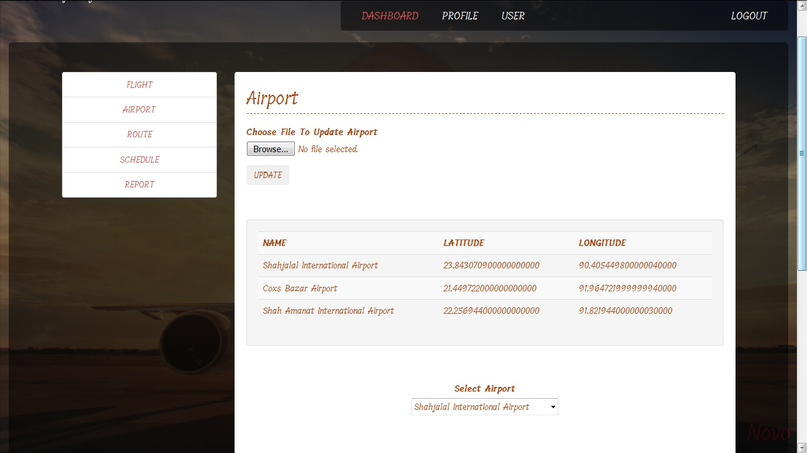
Add Airport Admin can add airport here by giving value(Airport name, Lititude, Longitude)

Slide 18
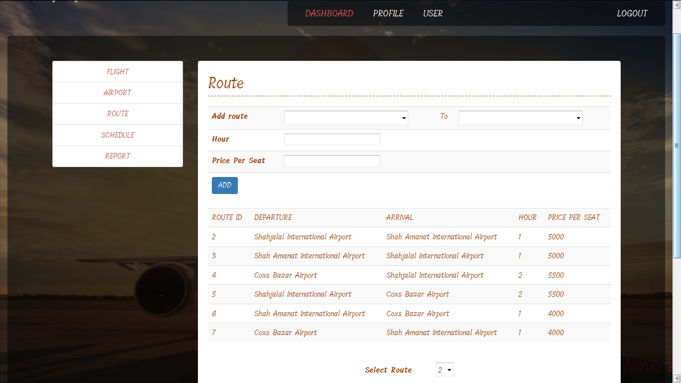
Create Route Admin can create route here by giving value(Departure airport, Destination airport, Hour/time, Price ).

Slide 19
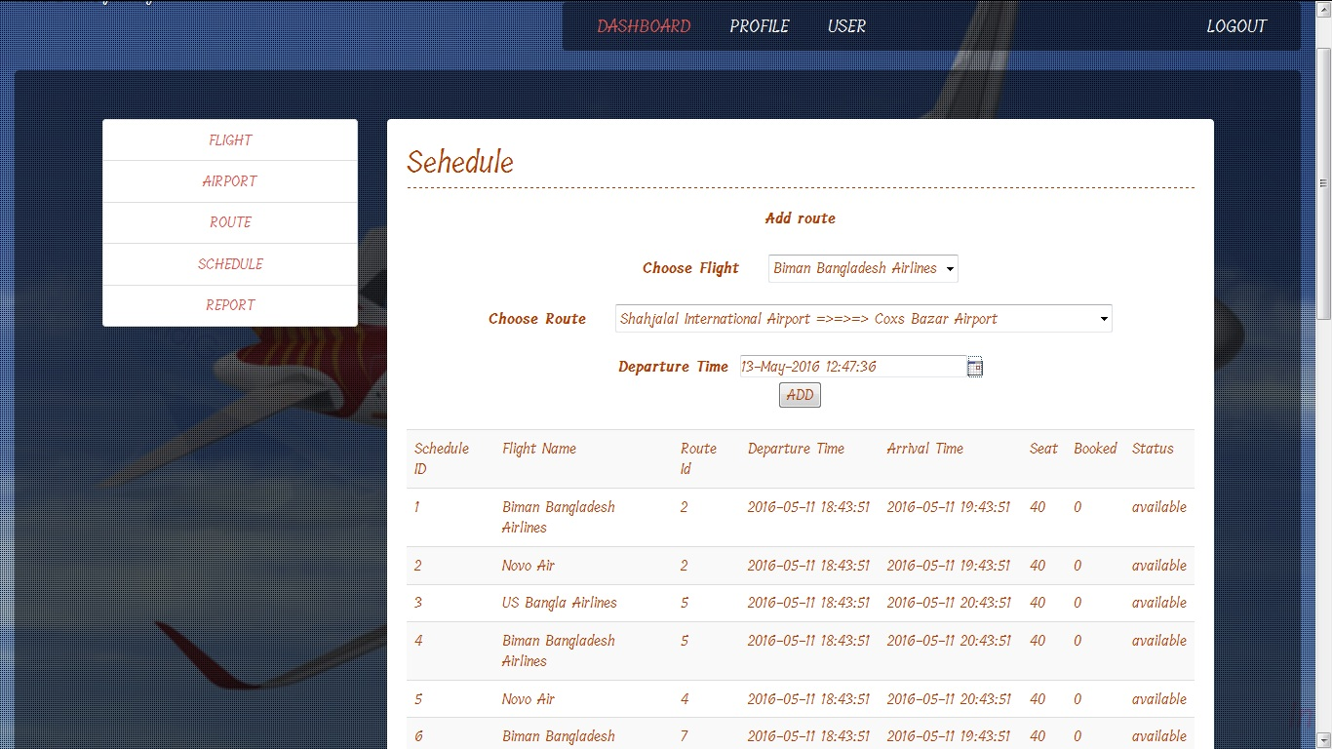
Add Schedule Admin can add flight schedule here by giving value(Choose flight, Choose Route, Departure time/date).

Slide 20
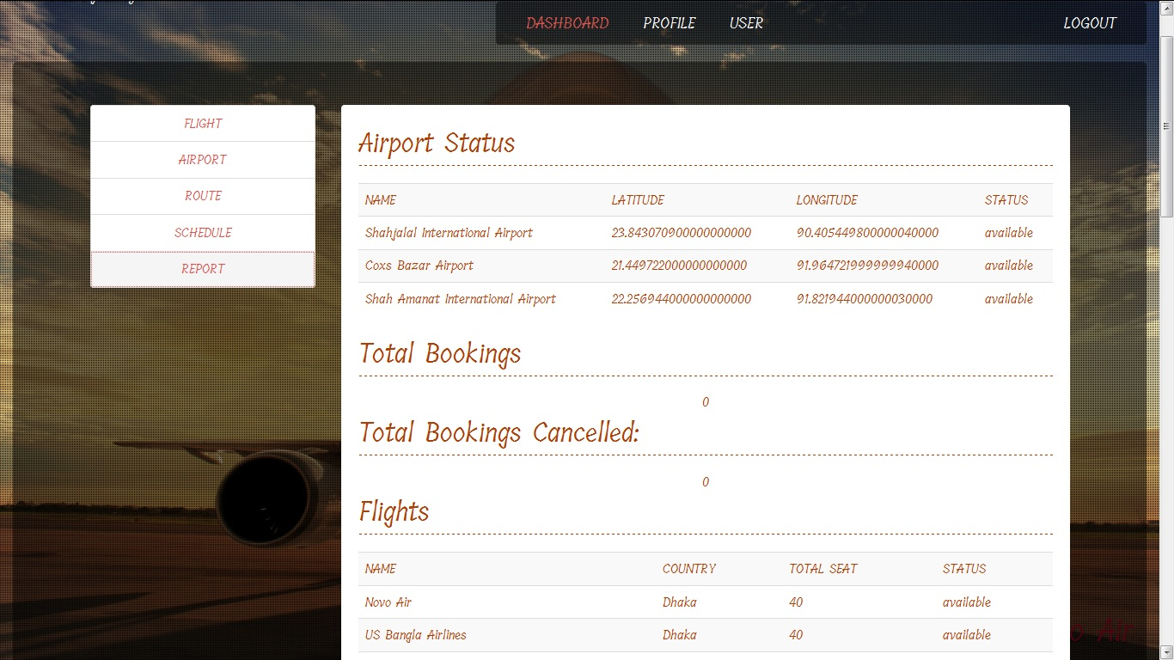
Report Admin can view report here about Airport status,Total booking, Total booking cancelled, Flights.

Slide 21
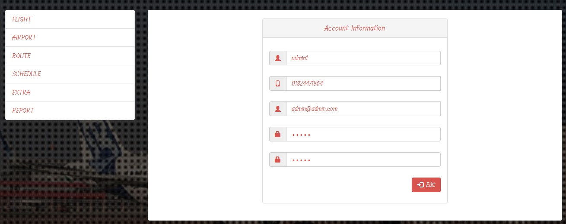
Admin profile
Admin can edit his/her profile information here. Admin can change password, email, user name, contact no.

Slide 22
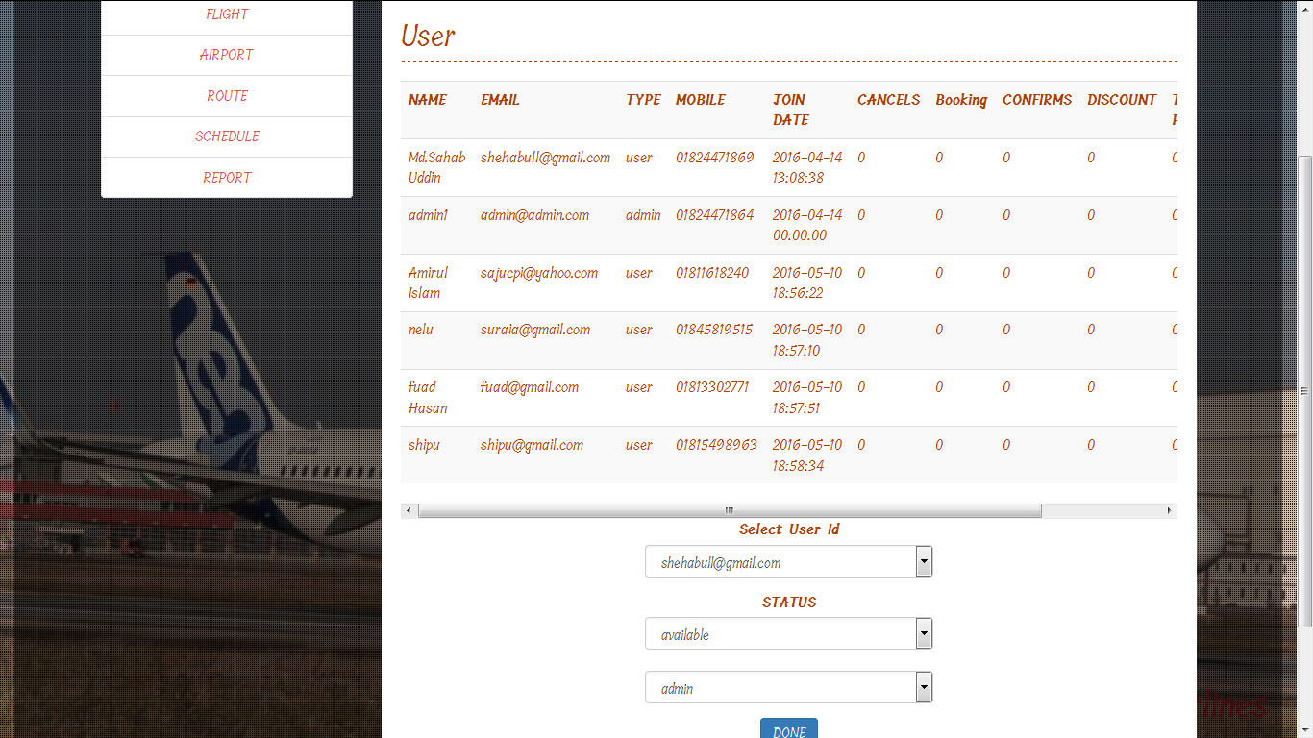
User Control
Admin also can access user data and status. Admin can change the status of a particular user by making (available/unavilable).

Slide 23
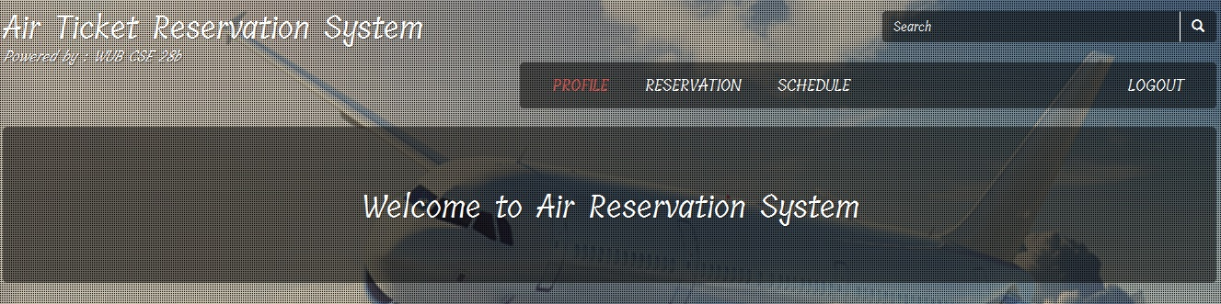
Registered User
When a registered user login into the system he/she can see the flight schedule .Can reserve, confirm and cancel ticket. And also can edit his profile information .

Slide 24
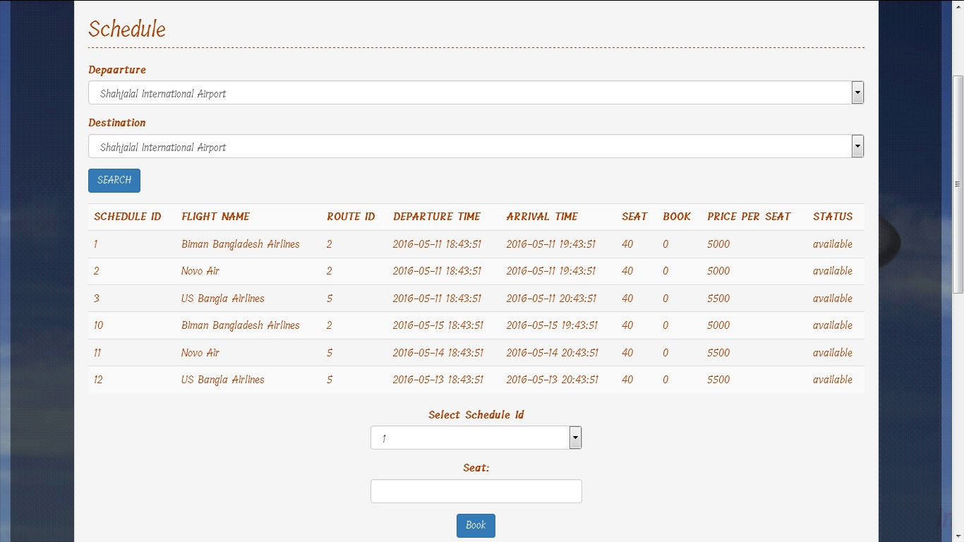
Flight Booking
Registered user can book flight by using value (Departure, Destination, Schedule id, Seat).

Slide 25
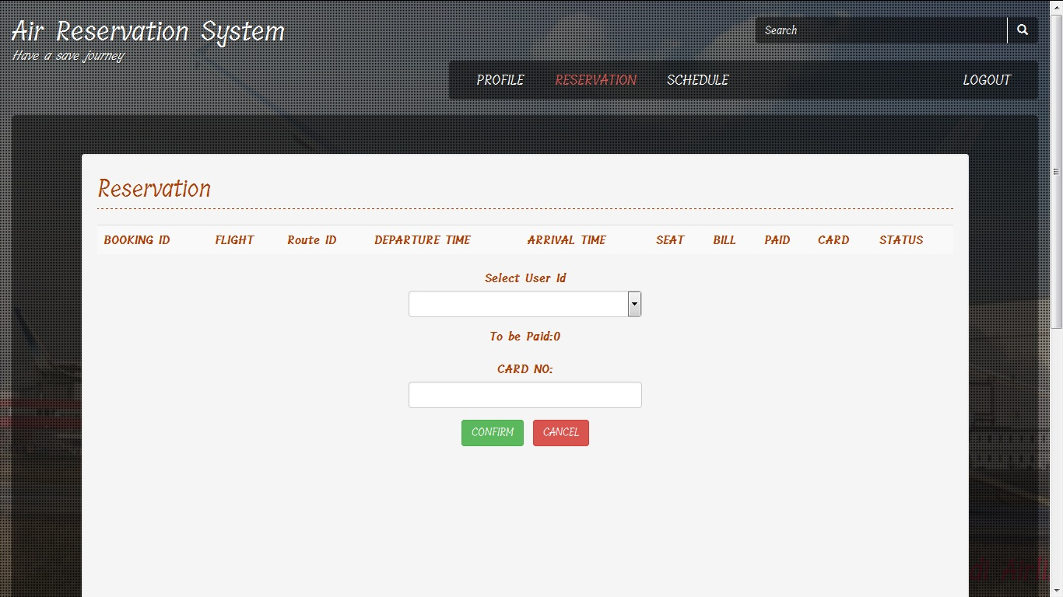
Confirm/Cancel Reservation
Registered user can confirm his/her reservation by giving value (User id, Card no). And also can cancel reservation very easily.

Slide 26
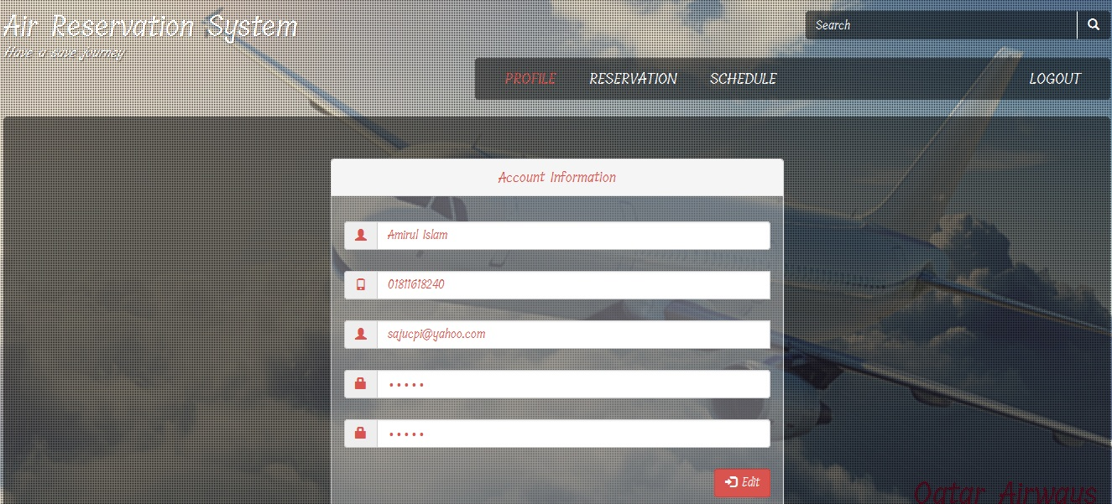
User Profile
Registered user also can edit his/her profile. User can update user name, contact no, email & password.

Slide 27
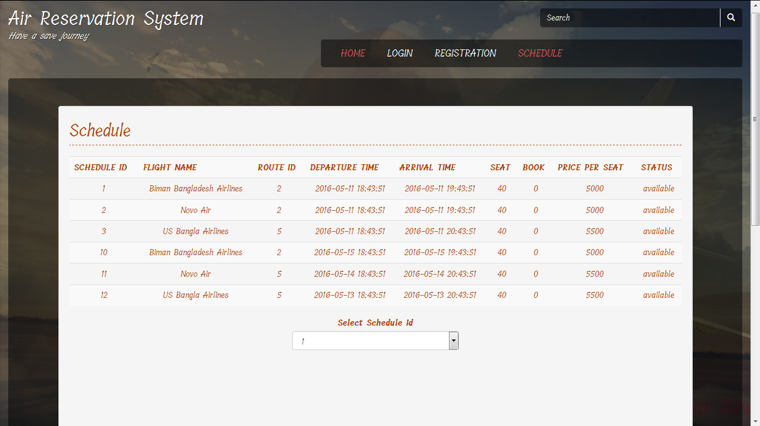
Unregistered User
When an unregistered user visit this site, he will see login , registration and flight schedule and also search option. He can only see the flight schedule but, can not reserve, confirm or cancel ticket for flight.

Slide 28
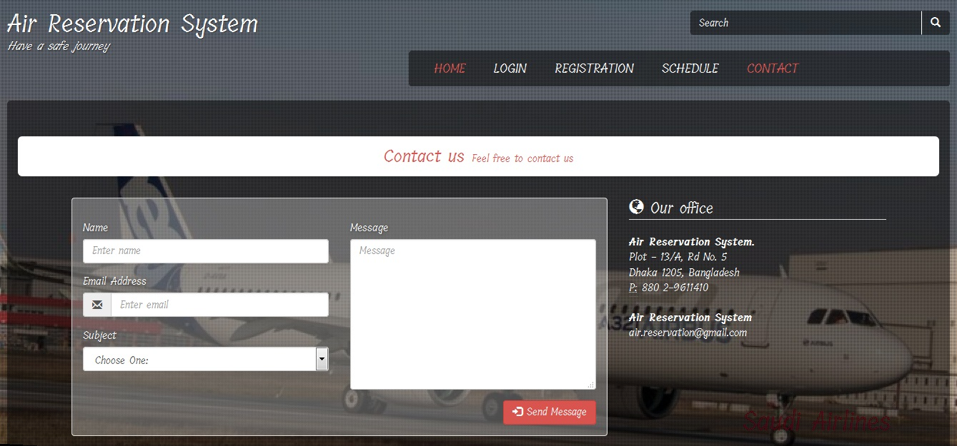
Contact Page In this page user can contact with admin for any inquiry or suggestion. User can mail admin using his/her email, user name with specific subject.

Slide 29
Limitations
Currently we are not able to introduce mobile verification system.
Currently we are not able to add online payment system.

Slide 30
Future Works
Develop mobile app of this system.
Introduce online payment system.
Add mobile verification system.
Introduce live chat between admin & user.

Slide 31
Conclusion
The online air ticket reservation automates the process of booking airline tickets, thus reducing the time wasted as well as the errors that are involved in the manual process. We analyzed different Air Ticket Reservation System worldwide and tried to gather different features from them. We accumulated all the feature currently used by the Air Reservation System apart from some graphical enhancements. In this project we had to think about the various options which we can provide to user. We have tried to make this project user friendly and also interactive by providing many features.
A lot of experimental work can be done with this project. Looking forward for any advice which can help us to improve the project.

Slide 32
Thank You

